Slide 1
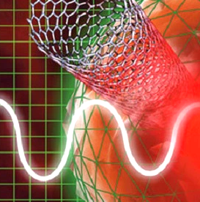
Carbon Nanotubes in Cancer Treatment
Victoria Mbakwe
Sarah Motz
Stephen Selvidge
Seth So
Notes:
all

Slide 2
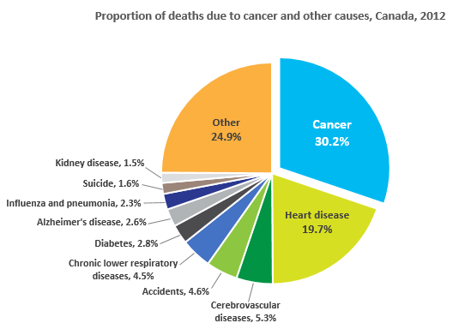
Background
Rate: 15 million cases of cancer are diagnosed per year globally
Common Types: Breast, Colorectal, and Lung
Current Methods: Chemotherapy, Radiotherapy, Surgical Resection
Downsides: Toxicity, Site non-targeting, Inefficacious and Collateral Damage
As a sturdy substrate, carbon nanotubes can provide potential solutions to these challenges.
Notes:
victoria

Slide 3
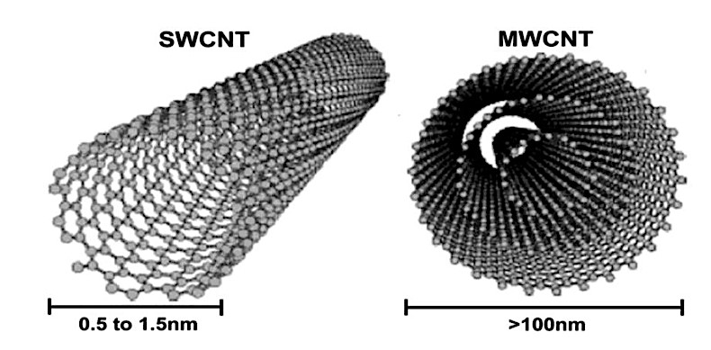
Carbon Nanotubes
Properties
Mechanical: 63 GPa, 1.3g/m3
Chemical: free electrons, large surface area
Fabrication
Chemical Vapor Deposition
Electric Arc Discharge
Laser Ablation
Types
SWCNT: Single-Walled Carbon Nanotubes
MWCNT: Multi-Walled Carbon Nanotubes
Notes:
stephen

Slide 4
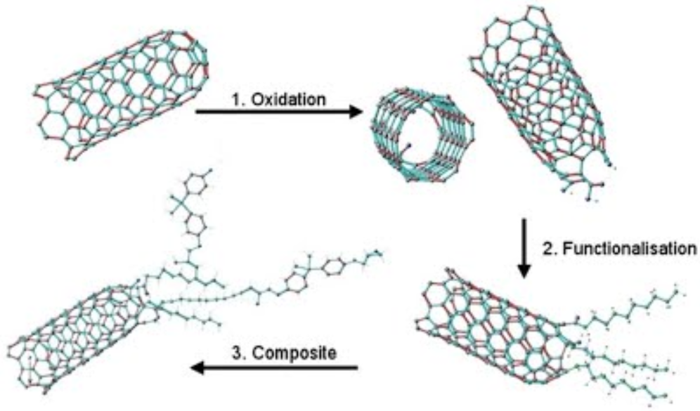
Functionalized CNTs
What are they?
• CNTs modified to be more biocompatible
Noncovalent Functionalization
• Bonding of biocompatible functional Groups to the surface of the CNT
• Preserves the aromatic structure
Covalent Functionalization
• Oxidation with strong acid results in attached carboxylic functional group
• Alters chemical properties of side walls
Notes:
tephen

Slide 5
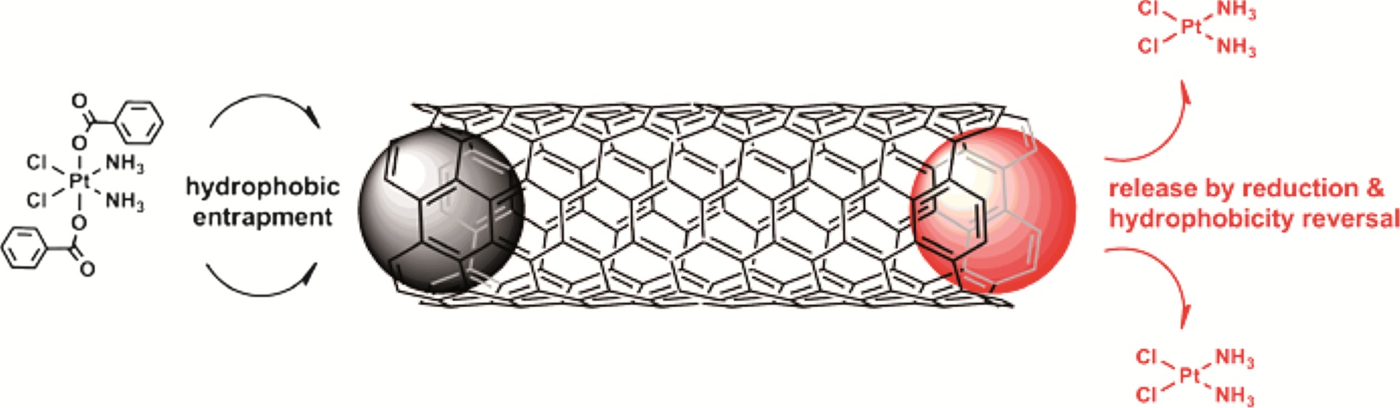
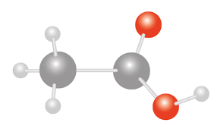
Transport
Loading
• Covalent – chemical binding via linker (Stanford)
• Noncovalent – physical conjugation (e.g. п-п stacking, electrostatic adsorption)
Targeting
• Functionalization – IgY antibodies
• Cell Uptake – diffusion and endocytosis based on side
Delivery
• Cleaving – direct or heat activated silica caps
Notes:
seth

Slide 6
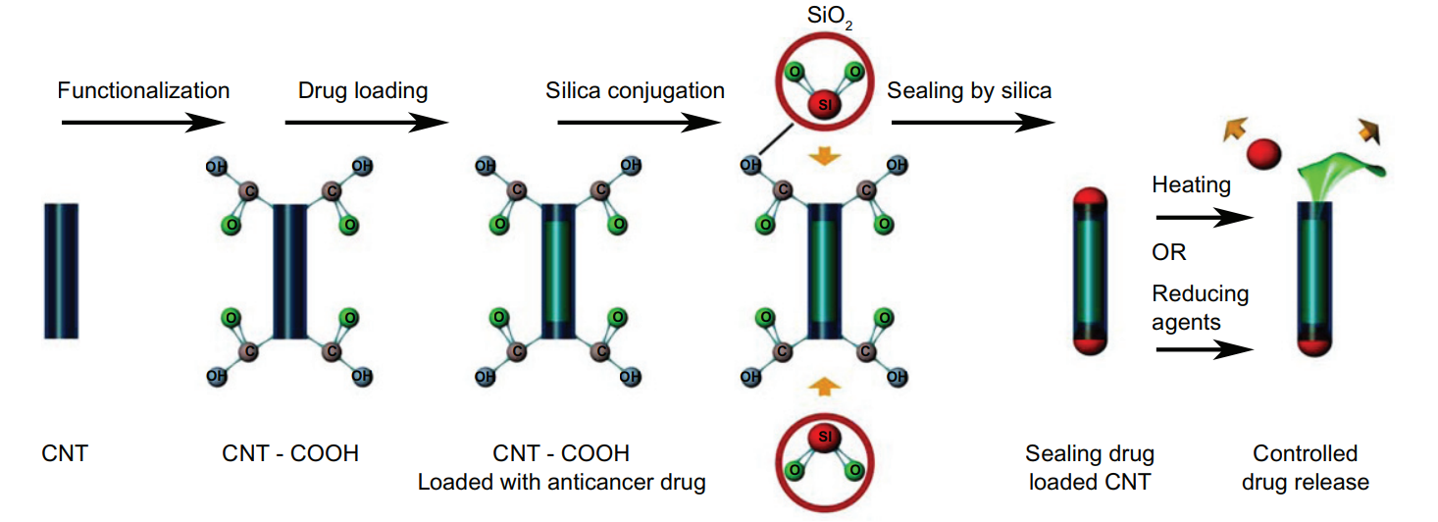
The Process:
Notes:
seth

Slide 7
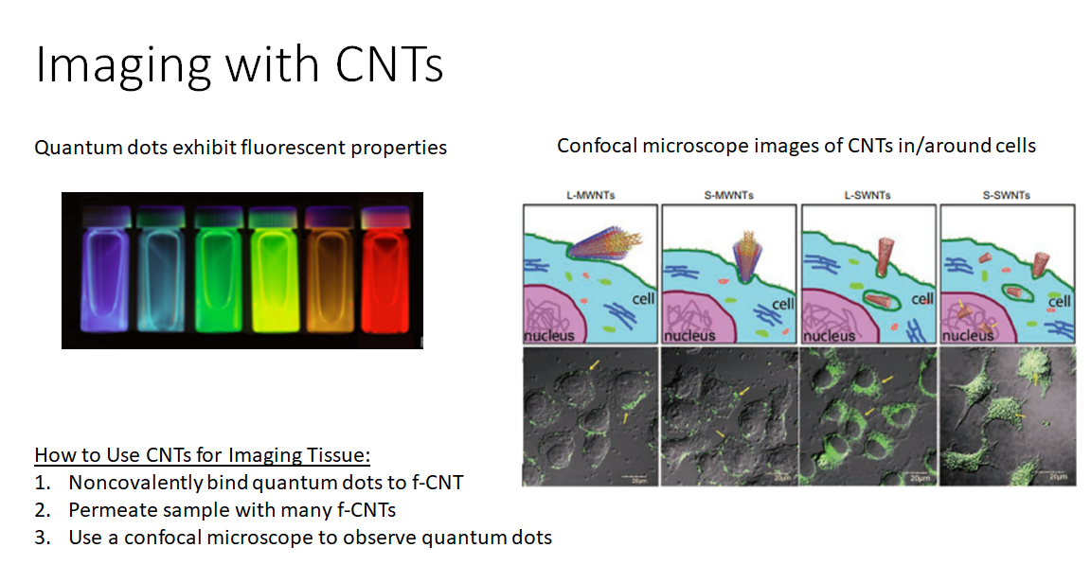
Image from Bawendi group, MIT Department of Chemistry
Notes:
sarah

Slide 8
Thermal Ablation
Thermal Ablation:
Cancer therapy to target cancer cells, without harming healthy cells
Excite nanostructures to selectively heat and destroy cancer cells
Short laser nanosecond exposure | Long laser exposure
Temperatures reach 300 C Nanosecond exposure Metastatic or individual tumor cell ablation Minimal damage to surrounding tissues | Temperature range: 45 C – 65 C Few minutes of laser exposure For relatively large primary cancer cells Disables cell function via thermal protein denaturation; affects healthy tissues
Notes:
victoria

Slide 9
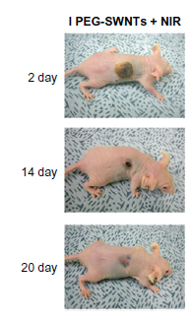
Thermal Ablation
Proposed Method: CNT-Mediated Thermal Ablation
Laser-simulated CNT penetrates deeper than laser beam treatment
CNT exposed to 700-1100 nm radiofrequency can destroy cancer cells without affecting healthy tissues
Heat Shock Protein Experiment:
Previous method: cancer cells exposed to only the laser results in a heat shock protein expression near the incident laser
Proposed method: laser exposed to CNTs results in heat shock protein expression is observed in deeper tissue
Conclusion: CNTs can be used to target cancer cells deep in malignant tissues
Notes:
victoria

Slide 10
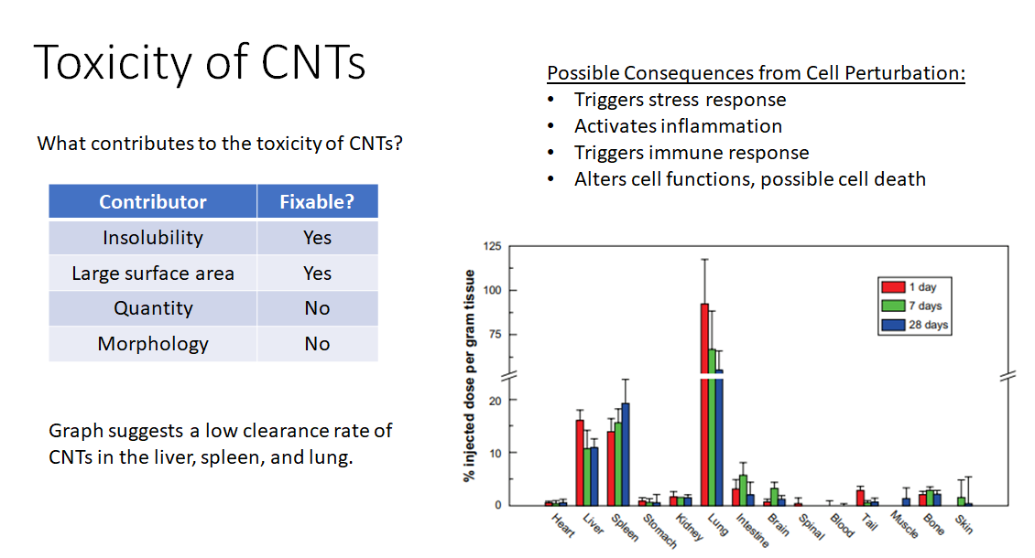
Notes:
sarah

Slide 11

Conclusions
What must be done to integrate CNTs in the body?
What are the three main functions of CNTs for cancer treatment?
What are the risks of using CNTs for cancer treatment?
What must be done in order for CNTs to be used as standard cancer treatment?
Notes:
Seth

Slide 12
References
Bianco, A., Kostarelos, K. and Prato, M. (2005). Applications of carbon nanotubes in drug delivery. Current Opinion in Chemical Biology, 9(6), pp.674-679.
Madani, S., Naderi, N., Dissanayake, O., Tan, A. and Seifalian, A. (2011). A new era of cancer treatment: carbon nanotubes as drug delivery tools. International Journal of Nanomedicine, p.2963.
www.cancer.ca. (2018). Cancer statistics at a glance - Canadian Cancer Society.
Williams, Mike. “Nanotubes Are Beacons in Cancer-Imaging Technique.” Rice News, 20 May 2016.

Slide 13
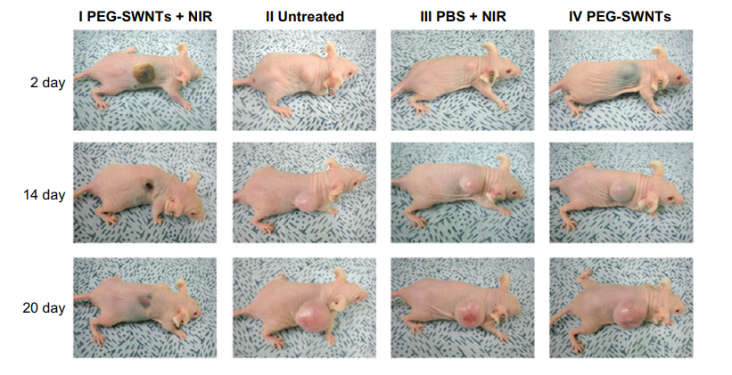
CNT Laser Ablation

